Slide 1


JAVA PROJECT WORKSHOP
(JDBC – Part 1)
Lecture 1

Slide 2
Introduction To JDBC
Unofficial full-form of JDBC is Java Database Connectivity.
It is an API used for connecting programs written in java with the relational database.
Programs developed with Java/JDBC are platform and vendor independent.

Slide 3
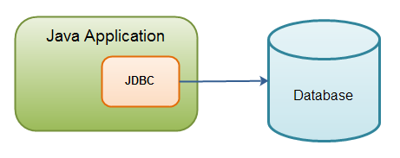
Introduction To JDBC

Slide 4
History And Edition
JDBC is maintained by JavaSoft, a sister concern of
Oracle-SUN
It was released as a part of JDK 1.1 on February 19,1997 and was called JDBC 1.0.
Later in 2006 , with Java 6, JDBC 4.0 was released
Java SE 8 includes the latest version of JDBC called JDBC 4.2

Slide 5
How JDBC maintains connection to the database ?
JDBC communicates with the database using a special set of classes called Driver classes .
These driver classes perform the real communication with the database in it’s native form.
Further to manage these driver classes JDBC provides another top level class called DriverManager

Slide 6
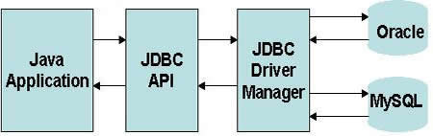
How JDBC maintains connection to the database ?

Slide 7
JDBC Driver Types
Today, there are four types of JDBC drivers in use:
Type 1: JDBC-ODBC bridge Driver.
Type 2: Partial Java Driver.
Type 3: Network API Driver
Type 4: Pure Java Driver

Slide 8
JDBC-ODBC Bridge Driver
The JDBC-ODBC bridge driver uses ODBC driver to
connect to the database.
ODBC stands for Open Database Connectivity and is a
Microsoft technology
The JDBC-ODBC bridge driver converts JDBC
method calls into the ODBC function calls.

Slide 9
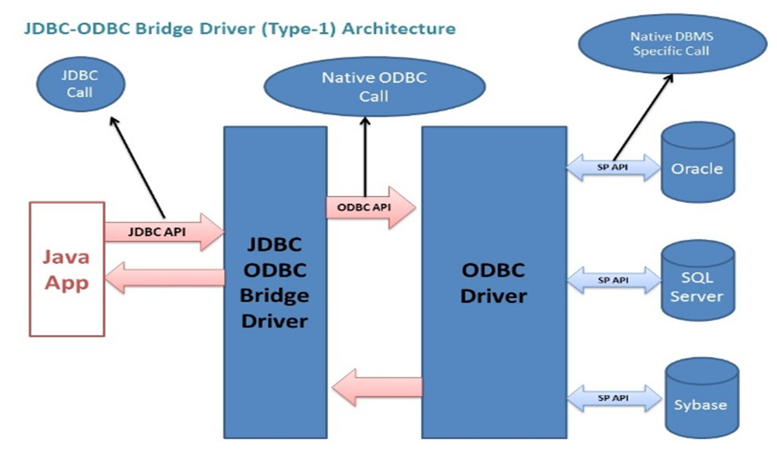
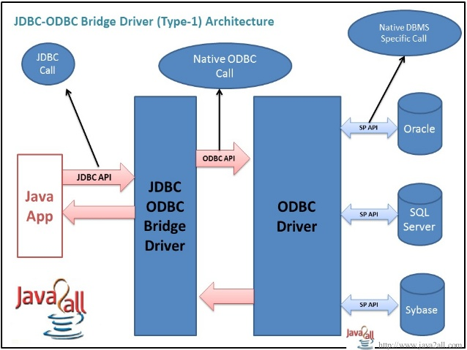
Architecture

Slide 10
JDBC-ODBC Bridge
Advantage:
Can be used to connect with variety of databases.
It’s an easy for installation as well as easy(simplest) to use as compare the all other driver.
Continued

Slide 11
JDBC-ODBC Bridge
Disadvantage:
This is the slowest driver.
Since it is a Microsoft technology so our java application can use it only when it runs on Windows platform.
It only supports basic SQL types like varchar2,number,date but doesn’t supports advanced types like BLOB,CLOB etc
Continued

Slide 12
Pure Java Driver
It is also called Native Protocol Driver
This is because it converts JDBC calls directly
into the vendor specific database protocol.
Moreover it is fully written in Java language.

Slide 13
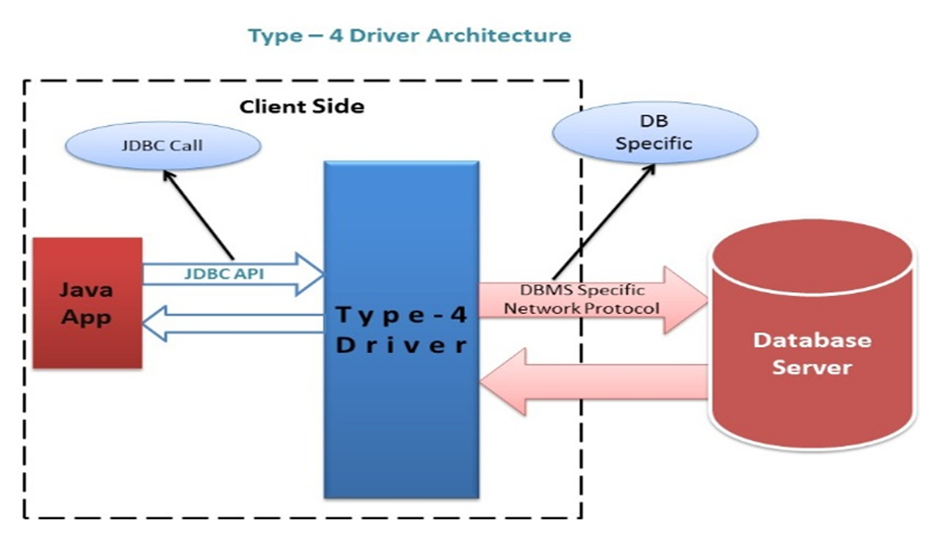
Architecture

Slide 14
Advantage And Disadvantage
ADVANTAGE:
Better performance
No middleware is needed while connecting to the database.
DISADVANTAGE:
Drivers are dependent on dataabse.
There is a separate driver for each database.

Slide 15
Steps Of Connectivity
There are 7 steps to connect any java application with the database in java using JDBC. They are as follows:
Import the required packages
Load and Register the driver class
Obtain the connection
Obtain the statement
Executing queries
Process the result
Close the connection

Slide 16
Step - 1 Importing The java.sql Package
The first step in JDBC is to import the package java.sql.
The java.sql package contains the entire JDBC API that sends SQL (Structured Query Language) statements to relational databases and retrieves the results of executing those SQL statements.

Slide 17
Step - 2 Loading And Registering The Driver
We must register the driver in our program before we use it.
Registering the driver is the process by which the Oracle driver's class file is loaded into the memory, so it can be utilized as an implementation of the JDBC interfaces.
We need to do this registration only once in our program.

Slide 18
Step - 2 Loading And Registering The Driver
Method Used For Loading and Registering The Driver
The forName() method of class Class is used to register the driver class. This method is used to dynamically load the driver class.
Syntax:
public static Class forName(String className)throws
ClassNotFoundException
Example:
Class.forName("oracle.jdbc.driver.OracleDriver");

